Slide 1
Network Protocols
UBMS Stem Experience: Jurassic Park

Slide 2

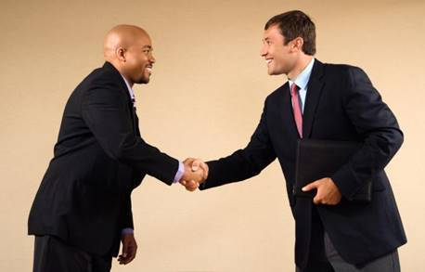


Protocols
Notes:
What is a protocol in general?
An agreed upon set of rules
Social constructs are protocols
Can differ from one culture to another
Breaking the protocol causes problems
Offense, awkward moments, etc
What is a telecommunications protocol?
An agreed format for transmission between two devices.
A set of rules and procedures for effective communication. The protocol determines:
What type of error checking will be used
If there will be any data compression
How to signal end of transmission
How to signal receipt of transmission
Etc…..

Slide 3

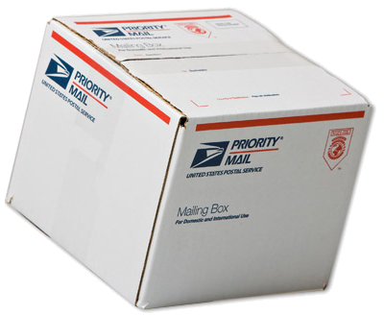
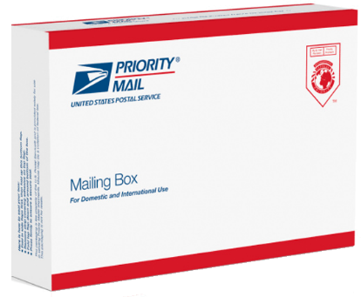
Protocol Example…
USPS Protocol
You need an appropriate container, in this case, an adequate envelope
Notes:
In order to further understand what are protocols, let us use the USPS as an example. When we want to send mail or a parcel, we just cannot write our message wrap it up in anything, say, plastic or any paper. The USPS will not accept it, they will tell us that we need to use a particular appropriate envelope or box, or special bag that they can supply.
Once we understand this then we have a portion or part of the mailing process solved.

Slide 4
Protocol Example…
USPS Protocol
MR. FRAGILE WINDOWS
123 OneWay Street
Crashstate, World
101111000
Be aware that you need to also follow other rules when writing an address, like how to write it, where to write it. A protocol within a protocol : a protocol suite.
You need to include a source address, who is sending the letter.
The return address
Notes:
Furthermore, we need to provide a sender’s address in order for the USPS to be able to return the letter to you in case it is unable to deliver it to a recipient. Again, we all know how to write an address by now. This particular senders address has to be in a particular location as well.

Slide 5
Protocol Example…
USPS Protocol
MR. FRAGILE WINDOWS
123 OneWay Street
Crashstate, World
101111000
Be aware that you need to also follow other rules when writing an address, like how to write it, where to write it. A protocol within a protocol : a protocol suite.
MR. UBIQUITOS PENGUIN
999 Solar Wind Street
Somewhere, World
10001100
You also need to include a destination address, who you are sending it to.
Notes:
So now we have our envelope (container) set and still, we cannot just send our letter to our intended recipient, we need to be able to identify to whom we are sending this piece of mail. In order for us to do this we need to provide our recipient’s address.
Again, we just do not scribble the address anywhere, it must be in a specific location and written down in a particular manner, otherwise, it might be undeliverable. The rules for writing an address is something that was introduced to all of us way back from our elementary school days.

Slide 6
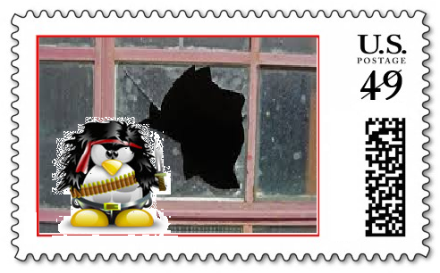
Protocol Example…
USPS Protocol
MR. FRAGILE WINDOWS
123 OneWay Street
Crashstate, World
101111000
Then we need to pay for the service, and we do that by affixing a stamp that we purchase based on physical characteristics. Again, we have to follow rules when affixing the stamp.
MR. UBIQUITOS PENGUIN
999 Solar Wind Street
Somewhere, World
10001100
Notes:
Then we need to pay for the service and we do that by affixing a stamp that we purchase based on physical characteristics. Again, we have to follow rules when affixing the stamp, do we just stick it any where? It might work but there are preferred locations where to place them.

Slide 7
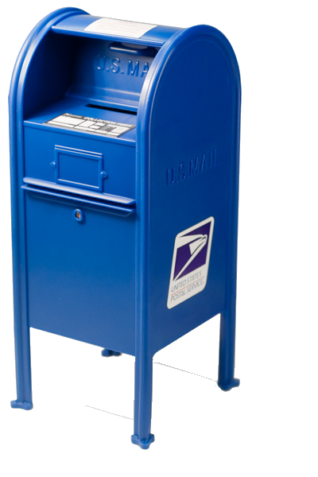
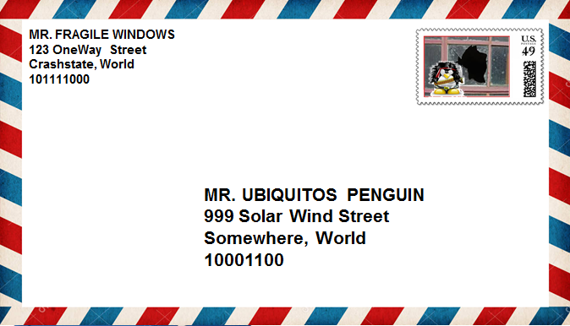
Protocol Example…
USPS Protocol
Then we must have a way to get it to the USPS network, be it via a public mail box, mail carrier, take it to the post office and so on.
Notes:
So, we have done all that is required from us and yet we still cannot send our letter, we still need to either drop it in a special container, or at a location in order for this letter to start its journey.
Keep in mind that even at this point, we are not sure it will get to its destination. We are totally relying on the given track record of the USPS on reliability. We are thrusting that they know how to get this letter to our recipient.
At this point we are not really concerned how it is actually transferred from our address to the recipient’s address. For the most part this is what a non-technical person will do. All we know is that we click on send and our email gets delivered. Those of us in CNM, we need to know how it is done all along from point A to point B.

Slide 8
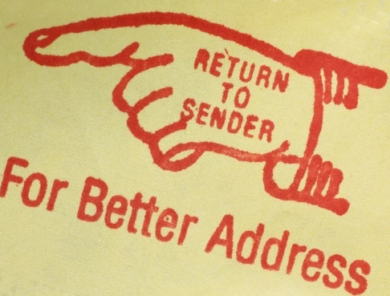
If you don’t follow the protocol...
Notes:
As a result, once we follow all the rules and regulations stipulated by the USPS, your mail will successfully get to the recipient.
if there are errors, then you must fix them
In some instances the mail will not get to its address
Incomplete or incorrect address
Recipient may have moved without you knowing
Post office errors
Might need to resend

Slide 9
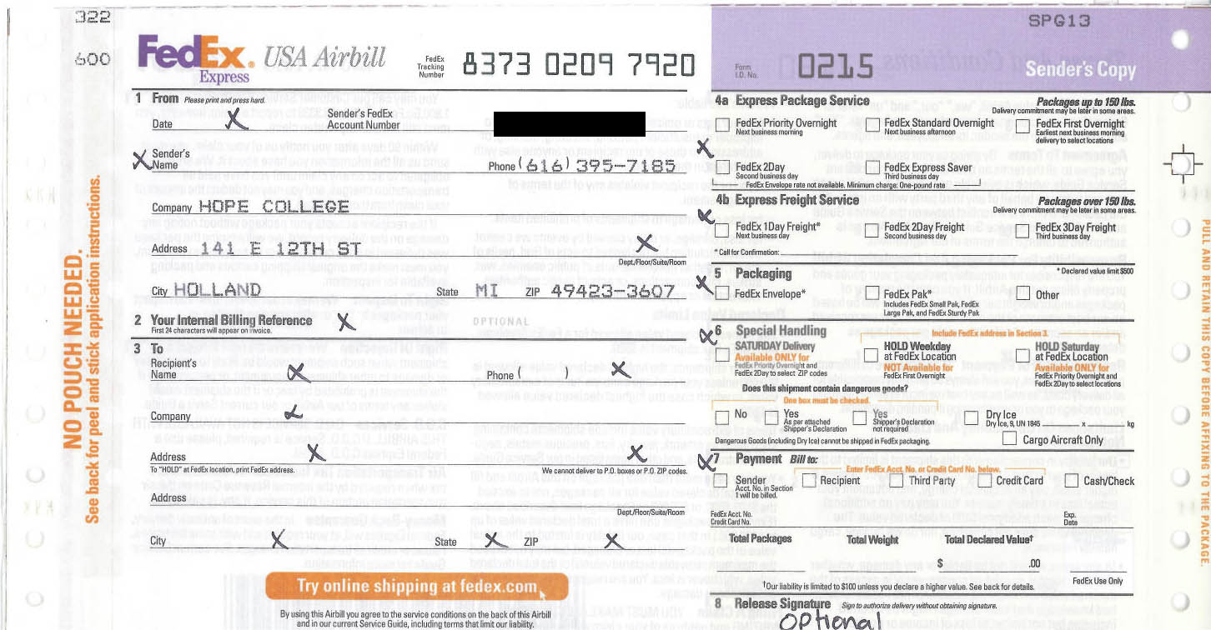
Protocol Example…
What about the FedEx Protocol?
Notes:
Let us look at another example, let us use FedEx. They are in the same business as USPS, which is of delivering mail, parcels, etc.
Even though they are in the same business, we just cannot take our USPS mail and use a FedEx facility to mail it, or vice versa. It will not work since each entity will let us know that we need to use the appropriate facility. This is so since they both use different procedures to get our mail across.

Slide 10

Client-Server Relationship

Slide 11
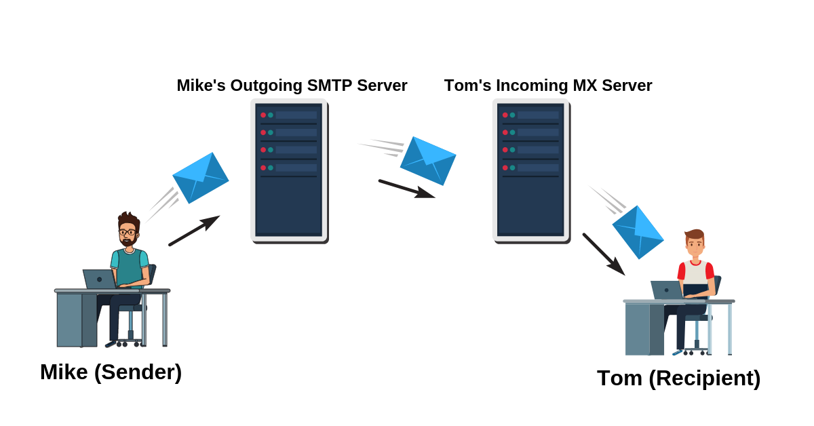
Sending Email

Slide 12
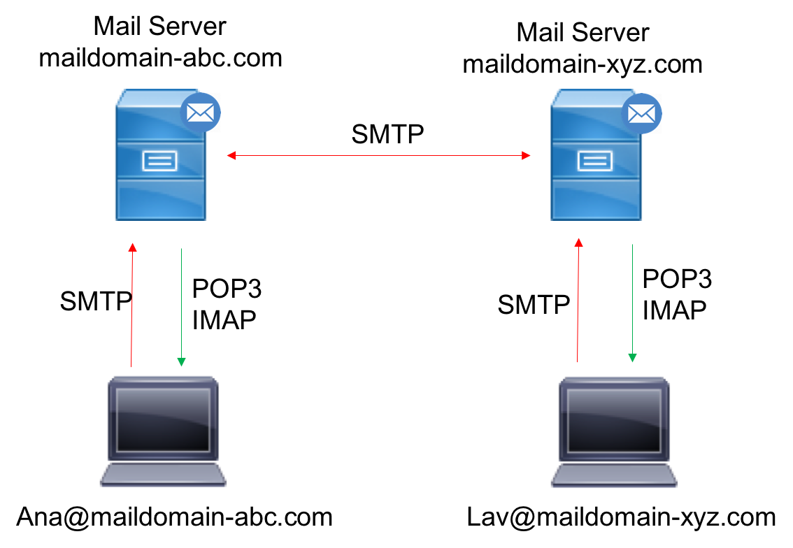
Email Servers

Slide 13


Web Browsing

Slide 14

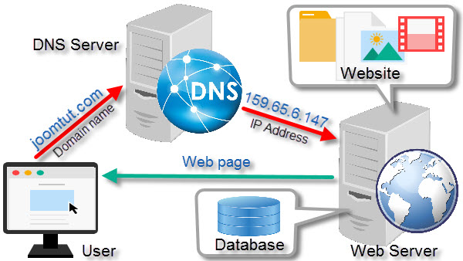

Slide 15
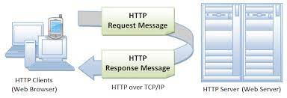
HTTP Protocol

Slide 16

HTTP Codes

